Slide 1
CHANGALI RADHAKRISHNA GOUD
Final Project
3/21/2024 Annual Review

Slide 2
PROJECT TITLE
UNMASKING KEYLOGGERS
3/21/2024 Annual Review

Slide 3


AGENDA
UNMASKING KEYLOGGER
Welcome to the world of invisible threats. Today, we will uncover the hidden danger of keyloggers and explore creative solutions to protect your digital life.
3/21/2024 Annual Review

Slide 4

PROBLEM STATEMENT
The problem statement is that the keylogger can be detected using antiviruses. Installation of hardware keylogger is difficult without the knowledge of the owner of the system. The solution to the above existing problem is that we can build a software keylogger instead of hardware keylogger.
3/21/2024 Annual Review

Slide 5

PROJECT OVERVIEW
Keylogger can be implemented in different ways. They may be software-based, where a program is installed on a computer to capture keystrokes, or hardware-based, involving physical devices connected between the keyboard and the computer. Some advanced keylogger can also capture screenshots, log mouse clicks, and monitor other activities.
It's important to note that the use of keylogger without the consent of the individual being monitored is generally considered unethical and, in many cases, illegal. Privacy laws and regulations vary by jurisdiction, and individuals have the right to know and consent to being monitored.
3/21/2024 Annual Review

Slide 6
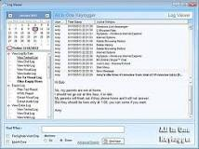

WHO ARE THE END USERS?
loggers use a Windows application programming interface (API) to intercept keyboard and mouse movements. GetAsyncKeyState or GetKeyState API functions might also be captured. These keyloggers require the attacker to actively monitor each key press
3/21/2024 Annual Review

Slide 7

YOUR SOLUTION AND ITS VALUE PROPOSITION
Everyone should keep there password and personal data safety
Keylogger can make destroy everything the data of details.
I have done project by keylogger on pythons
For these project step to get output on code
1)python IDLE
2)cmb
3)oracle and kali Linux
4)text editor
These applications are used to do code on python.
3/21/2024 Annual Review

Slide 8
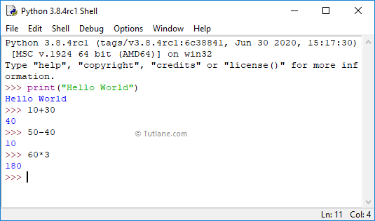
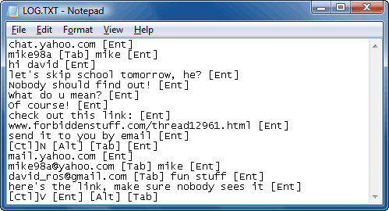

THE WOW IN YOUR SOLUTION
3/21/2024 Annual Review
8

Slide 9
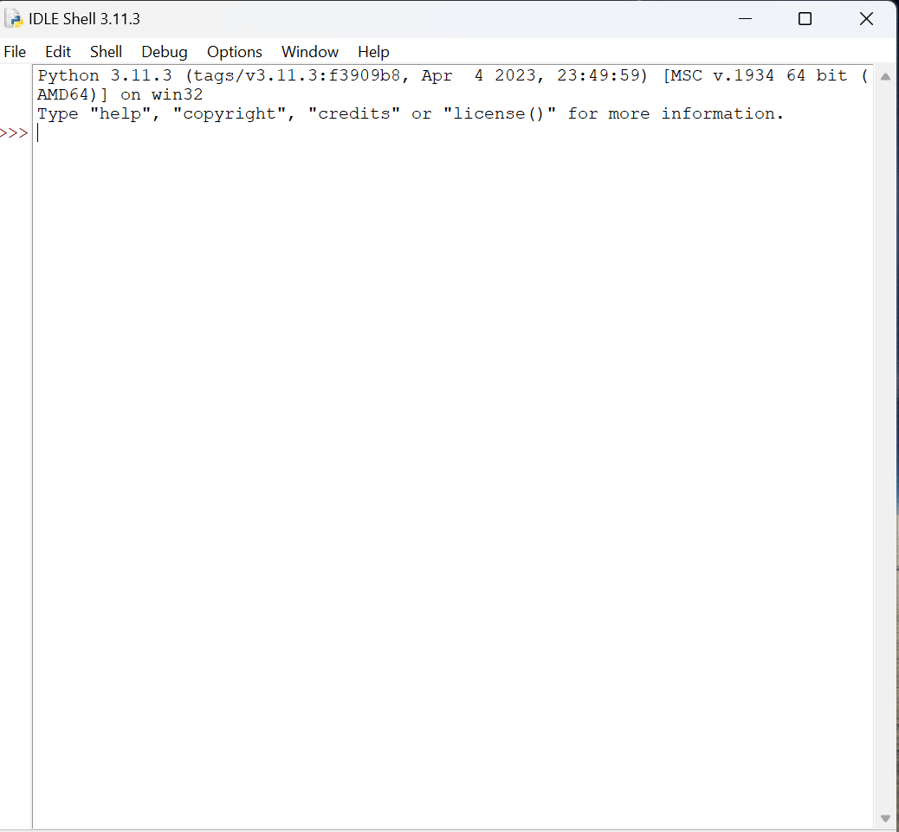
MODELLING
Teams cam add wireframes
These are code on the python idle with oracle
With kali lixnu
Hello this krish
3/21/2024 Annual Review
9

Slide 10
RESULTS
This out put of key_json
[{"Pressed": "'h'"}, {"Held": "'h'"}, {"Released": "'h'"}, {"Pressed": "'e'"}, {"Held": "'e'"}, {"Released": "'e'"}, {"Pressed": "'l'"}, {"Held": "'l'"}, {"Released": "'l'"}, {"Pressed": "'l'"}, {"Held": "'l'"}, {"Released": "'l'"}, {"Pressed": "'o'"}, {"Held": "'o'"}, {"Released": "'o'"}, {"Pressed": "Key.space"}, {"Held": "Key.space"}, {"Released": "Key.space"}, {"Pressed": "'e'"}, {"Held": "'e'"}, {"Released": "'e'"}, {"Pressed": "'v'"}, {"Held": "'v'"}, {"Released": "'v'"}, {"Pressed": "'e'"}, {"Held": "'e'"}, {"Released": "'e'"}, {"Pressed": "'r'"}, {"Held": "'r'"}, {"Released": "'r'"}, {"Pressed": "'y'"}, {"Held": "'y'"}, {"Released": "'y'"}, {"Pressed": "'o'"}, {"Held": "'o'"}, {"Released": "'o'"}, {"Pressed": "'n'"}, {"Held": "'n'"}, {"Released": "'n'"}, {"Pressed": "'e'"}, {"Held": "'e'"}, {"Released": "'e'"}, {"Pressed": "Key.space"}, {"Held": "Key.space"}, {"Released": "Key.space"}, {"Pressed": "'t'"}, {"Held": "'t'"}, {"Released": "'t'"}, {"Pressed": "'i'"}, {"Held": "'i'"}, {"Released": "'i'"}, {"Pressed": "'h'"}, {"Held": "'h'"}, {"Released": "'h'"}, {"Pressed": "Key.backspace"}, {"Held": "Key.backspace"}, {"Released": "Key.backspace"}, {"Pressed":
This out put of key-log text
'h''e''l''l''o'Key.space't''h''i''s'Key.space'k''r''i''s''j'Key.backspace'h'Key.spaceKey.backspaceKey.backspaceKey.backspaceKey.backspaceKey.backspaceKey.backspaceKey.backspaceKey.backspaceKey.backspaceKey.backspaceKey.backspace'e''v''e''r''y''o''n''e'Key.space't''h''i''s'Key.space'k''r''i''s''h'
3/21/2024 Annual Review
10

